Slide 1
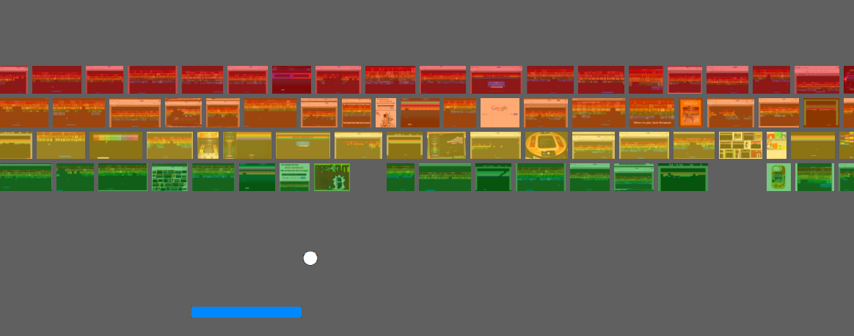
Atari Breakout &
Deep Q-Networks
DS4기 5조
박 봉현, 박 선영, 조 남영

Slide 2
Model Test

Slide 3
Model Tuning
Learning Rate
Learning Rate
Learning Rate
Learning Rate
--------------------------------
Default : 0.001
--------------------------------
History : 0.00025
--------------------------------
Score :
Time :
--------------------------------
--------------------------------
Default : 0.001
--------------------------------
History : 0.00025
--------------------------------
Score :
Time :
--------------------------------
--------------------------------
Default : 0.001
--------------------------------
History : 0.00025
--------------------------------
Score :
Time :
--------------------------------
--------------------------------
Default : 0.001
--------------------------------
History : 0.00025
--------------------------------
Score :
Time :
--------------------------------

Slide 4
Final Result
Score : 1,000 Time : 20’ 00

Slide 5
Model Test
Add Title
Add Title
You can simply impress your audience and add a unique zing and appeal to your Presentations. Easy to change colors, photos and Text.
You can simply impress your audience and add a unique zing and appeal to your Presentations. Easy to change colors, photos and Text.
S
W
T
O
Add Title
Add Title
You can simply impress your audience and add a unique zing and appeal to your Presentations. Easy to change colors, photos and Text.
You can simply impress your audience and add a unique zing and appeal to your Presentations. Easy to change colors, photos and Text.

